Slide 1
Arithmetic operators

Slide 2
Outline
In this lesson, we will:
  Define binary arithmetic operators
    Addition, subtraction, multiplication and division
    Integer division
    Remainder/modulus operator
    Conversion of integers to floating-point
  Look at order of operations
    Standard conversions and order of operations
  Consider initialization of and assignment to local variables
  Describe the unary arithmetic operators
    Negation and “+”

Slide 3
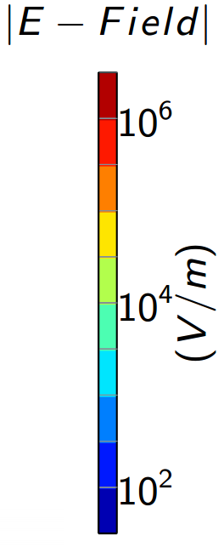
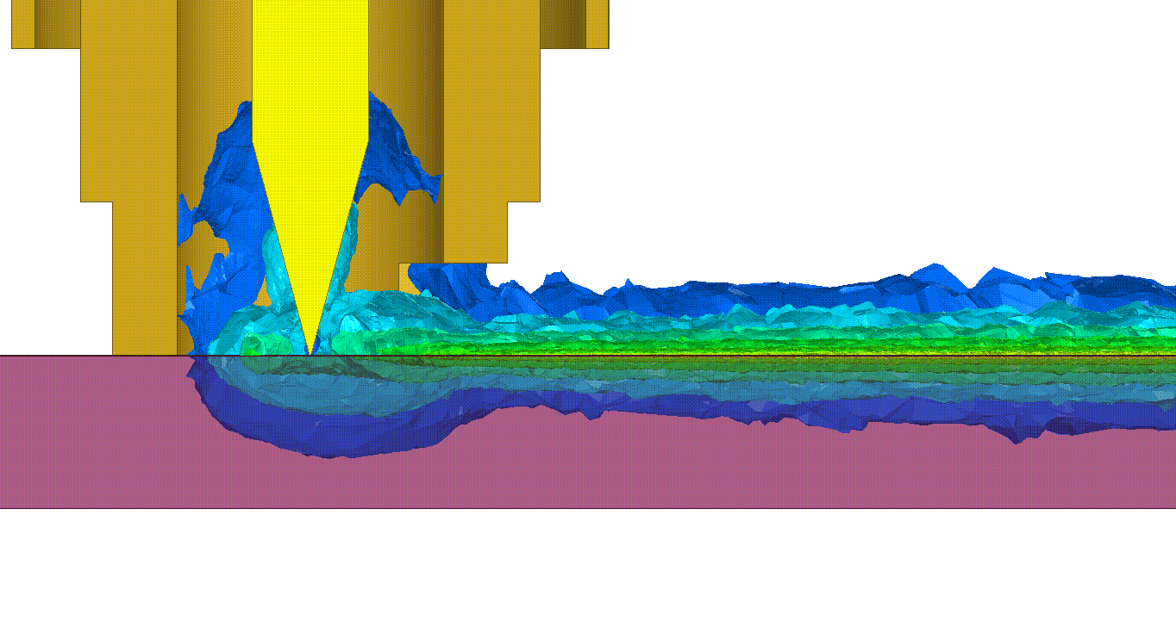
Arithmetic operations
Most engineering computations involve simulations of the real world, requiring the application of mathematics and modelling
  The A380 double-decker jumbo jet was simulated entirely in software prior to being built for the first time…
  Processors and circuits are simulated using mathematical models
Here we see a mathematical model of a quantum socket [1]:

Slide 4
Arithmetic operations
A binary arithmetic operator takes two numerical operands and evaluates that arithmetic operation
  The operands may be integers or floating-point
  They may be literals or local variables
The available binary arithmetic operators are
binary operator
3 + 5
operands
Operation | Operator | Integers | Floating-point
Addition | + | 3 + 5 | 3.2 + 7.3
Subtraction | – | 7 - 6 | 9.5 - 4.1
Multiplication | × | 8*9 | 1.5*2.7
Division | ÷ | 1/2 | 4.5/9.6
Remainder | n/a | 5%3 | -
Note: For clarity, it is usual to place spaces around + and -
but no spaces around * / or %

Slide 5
Arithmetic expression
An arithmetic expression is any combination of operands combined with arithmetic operators
7.5
x*x + 1
6.0*width*height
pi*radius*radius
n*(n + 1)/2.0
n*n*(n + 1)*(n + 1)/4.0;
Arithmetic expressions can be:
  Printed
  Used to initialize local variables
  Assigned to local variables

Slide 6
Arithmetic operations
Juxtaposition is never acceptable to represent multiplication
If you entered 2xx - 3xy + 4yy, this would result in the compiler signalling an error
  2xx is neither a valid integer, floating-point number or identifier
There is no operator for exponentiation
  Exponentiation requires a function call to a C++ library
  More on this later…
2.0*x*x – 3.0*x*y + 4.0*y*y

Slide 7
Order of operations
The compiler uses the same rules from secondary school:
  Multiplication and division before addition and subtraction
    In all cases, evaluations go from left to right
    x + y/2.0 + z/a /b *c
    (x + y/2.0) + ((z/a)/b)*c
  Parentheses can be used either
    To enforce a different order of operations
    To clarify your intended order of operations

Slide 8
Order of operations
#include <iostream>
// Function declarations
int main();
// Function definitions
int main() {
std::cout << (1 + 2 + 3 + 4 * 5 * 6 + 7 + 8 + 9) << std::endl;
std::cout << (1 * 2 * 3 + 4 * 5 * 6 + 7 + 8 + 9) << std::endl;
std::cout << (1 * 2 * 3 * 4 * 5 + 6 + 7 + 8 + 9) << std::endl;
std::cout << (1 * 2 * 3 * 4 * 5 - 6 * 7 + 8 * 9) << std::endl;
return 0;
}

Slide 9
Order of operations
It is paramount to remember that parentheses can be used either to emphasize or enforce the order in which operations are performed
Common mistakes include:
k/m*n when they mean k/(m*n) or k/m/n
k/m+n when they mean k/(m + n)
k+m/n when they mean (k + m)/n
In two cases, spacing would help you see what is going on:
k/m+n k/m + n
k+m/n k + m/n

Slide 10
Initialization
Arithmetic expressions can be used to initialize a local variable:
    #include <iostream>
    // Function declarations
    int main();
    // Function definitions
    int main() {
    double x{};
    std::cout << "Enter a value of x: ";
    std::cin >> x;
    double y{ x*x - 2.0*x + 1.0 };
    std::cout << " 2" << std::endl;
    std::cout << "x - 2x + 1 = " << y << std::endl;
    return 0;
    }
Output:
6
.
5
Enter a value of x:
2
2
x - 2x + 1 = 30.4704

Slide 11
Assignment
Another example of initialization:
    // Function definitions
    int main() {
    double radius{};
    std::cout << "Enter the radius of a sphere: ";
    std::cin >> radius;
    double pi{3.1415926535897932}; // 17 digits of precision
    double volume{ 4.0/3.0*pi*radius*radius*radius };
    std::cout << "The volume of the sphere is " << volume << std::endl;
    double area{ 4.0*pi*radius*radius };
    std::cout << "The surface area is "<< area << std::endl;
    return 0;
    }
Output:
1
.
Enter a radius of a sphere:
5
The volume of the sphere is 14.1372
The surface area is 28.2743

Slide 12
Assignment
This also works, but is less pleasing…
    // Function definitions
    int main() {
    double radius{};
    std::cout << "Enter the radius of a sphere: ";
    std::cin >> radius;
    double pi{3.1415926535897932};
    std::cout << "The volume of the sphere is "
    << (4.0/3.0*pi*radius*radius*radius) << std::endl;
    std::cout << "The surface area is "<< (4.0*pi*radius*radius)
    << std::endl;
    return 0;
    }

Slide 13
Assignment
The result can also be assigned to a local variable:
    int main() {
    double x{};
    std::cout << "Enter a value of x: ";
    std::cin >> x;
    double y{};
    std::cout << "Enter an approximation of sqrt(x): ";
    std::cin >> y;
    y = (y + x/y)/2.0;
    std::cout << "A better approximation of sqrt(" << x << ") = "
    << y << std::endl;
    y = (y + x/y)/2.0;
    std::cout << "An even better approximation of sqrt(" << x << ") = "
    << y << std::endl;
    return 0;
    }

Slide 14
Assignment
Executing this program:
3
.
Enter a value of x:
5
1
.
Enter an approximation of sqrt(x):
8
A better approximation of sqrt(3.5) = 1.87222
A even better approximation of sqrt(3.5) = 1.87083
    y = (y + x/y)/2.0;
    std::cout << "A better approximation of sqrt(" << x << ") = "
    << y << std::endl;
    y = (y + x/y)/2.0;
    std::cout << "A even better approximation of sqrt(" << x << ") = "
    << y << std::endl;

Slide 15
Assignment
The left-hand side of an assignment operator
must be a local variable
  You cannot assign to an arithmetic expression
    2.0*x + 1.0 = y - 1.0;
    x = (y - 2.0)/2.0;
  Again, we emphasize, always read the above as
  “x is assigned the value of y minus two all divided by two.”

Slide 16
Integer division
In C++, the result of an arithmetic operation on integers must produce an integer
  This is a problem for division
std::cout << (1/2) << std::endl; // outputs 0
std::cout << (7/3) << std::endl; // outputs 2
std::cout << (-11/4) << std::endl; // outputs -2
std::cout << (188/13) << std::endl; // outputs 14
The result is the quotient discarding any remainder

Slide 17
Order of operations
Here are some further examples that depend on integer division:
std::cout << (1 / 2 + 3 * 4 + 5 * 6 * 7 - 8 * 9) << std::endl;
std::cout << (1 + 2 * 3 * 4 / 5 * 6 * 7 * 8 / 9) << std::endl;
std::cout << (1 * 2 + 3 + 4 * 5 * 6 / 7 * 8 + 9) << std::endl;
For example:
(1 / 2) + (3 * 4) + (5 * 6 * 7) - (8 * 9)
0
+ 12
+ 210
- 72
= 150

Slide 18
Integer remainder
Recall that in long division, you find the quotient and the remainder
quotient
remainder

Slide 19
Integer remainder
To find the remainder of a division, use the modulus operator %
  Also called the remainder operator
std::cout << (1 % 2) << std::endl; // outputs 1
std::cout << (7 % 3) << std::endl; // outputs 1
std::cout << (-11 % 4) << std::endl; // outputs -3
std::cout << (-175 % -13) << std::endl; // outputs -6
For any integers m and n, it is always true that
(n/m)*m + n%m equals n

Slide 20
Integer remainder
Let’s take a closer look at:
(n/m)*m + n%m
Don’t we know from mathematics that as long as m ≠ 0,
C++ evaluates one operation at a time
  If the compiler sees (7/3)*3,
    It first will have (7/3) calculated, which evaluates to 2
    It then proceeds to calculate 2*3 which is 6
?

Slide 21
Spacing around operators
In C++, you can put any amount of whitespace between operators and their operands:
    std::cout << ((n/m)*m + n%m);
    std::cout << ((n/m)*m+n%m);
    std::cout <<
    ( ( n
    / m )* m +
    n% m )
    ;
We recommend:
  Putting one space between operands and + and -
  Juxtaposing operands with *, / and % operands
Forcing your self soon makes it habitual
  You will not even think about it when you type…

Slide 22
Standard conversions
Suppose the compiler sees:
3.5/2
Does it use floating-point division, or integer division?
  The only way for this to make sense is for the compiler to interpret the 2 as a floating-point number
  This process is called a standard conversion
    Conversion of literals is performed by the compiler

Slide 23
Order of operations and conversions
Again, C++ is very exact when standard conversions occurs:
  Only when one operand is a floating-point number and the other is an integer is the integer converted to a floating-point number
What is the output of each of the following? Why?
std::cout << (10.0 + 3.0/(9/2)) << std::endl;
std::cout << (10.0 + 3.0/9*2) << std::endl;
std::cout << (10.0 + 3/(9/2.0)) << std::endl;

Slide 24
Unary operators
A unary operator has only one operand
  For example, from secondary school, the “!” is a unitary operator
    It only takes one operands, e.g., 5!
There are two unary operators for arithmetic:
  Unary negation operator changes the sign of what follows:
std::cout << -(1 + 2 + 3) << std::endl;
std::cout << -(2*3*4) << std::endl;
std::cout << -(1 + 2*3) << std::endl;
  Unary neutral operator ‘+’ leaves the sign unchanged:
std::cout << +(1 + 2 - 5) << std::endl;
std::cout << +(-2*3*4) << std::endl;
std::cout << +(1 - 2*3) << std::endl;

Slide 25
Standard conversions
If all of the operands are integers, the result will be an integer:
    35
    3 + 6 + 4 + 7 + 1
    12*(3 + 6)*(1 - 4)
    (5 + 3 + 7)/10;
    (56 - 1)*3*(4 + 1)
    -243 + 6
    +23
If even one operand is a float, the result of will be a float:
    35.0
    3 + 7 + 2.9 + 7 + 1.3
    12.5*(5 + 2)*(1.0 - 6)
    (3 + 2 + 1)/10.5;
    (6 – 1.7)*4*(8.9 + 1.7)
    -6.4 + 3
    +2.7

Slide 26
Arithmetic expression
We can now make the following statements:
  An integer arithmetic expression will always evaluate to an integer
  A floating-point arithmetic expression will always evaluate to a float
  A mixed arithmetic expression will always evaluate to a float

Slide 27
Summary
Following this presentation, you now:
  Understand the binary arithmetic operators in C++
    Addition, subtraction, multiplication and division
  Know that the result can:
    Initialize a local variable
    Be assigned to a local variable
  The effect of integer division and the remainder operator
  Conversion of integers to floating-point
  Understand the order of operations and standard conversions
  Are aware of the two unary arithmetic operators

Slide 28
References
[1] Thomas McConkey, a simulation of a 6 GHz microwave signal transmitting through a coaxial pogo pin onto a micro-coplanar waveguide transmission line of a thin film superconducting aluminium (i.e., a quantum socket). Developed with the Ansys software hfss.
[2] Wikipedia, https://en.wikipedia.org/wiki/Operators_in_C_and_C++#Arithmetic_operators
[3] cplusplus.com tutorial,
http://www.cplusplus.com/doc/tutorial/operators/
[4] C++ reference,
https://en.cppreference.com/w/cpp/language/operator_arithmetic

Slide 29
Acknowledgments
Proof read by Dr. Thomas McConkey and Charlie Liu.

Slide 30



Colophon
These slides were prepared using the Georgia typeface. Mathematical equations use Times New Roman, and source code is presented using Consolas.
The photographs of lilacs in bloom appearing on the title slide and accenting the top of each other slide were taken at the Royal Botanical Gardens on May 27, 2018 by Douglas Wilhelm Harder. Please see
https://www.rbg.ca/
for more information.

Slide 31
Disclaimer
These slides are provided for the ece 150 Fundamentals of Programming course taught at the University of Waterloo. The material in it reflects the authors’ best judgment in light of the information available to them at the time of preparation. Any reliance on these course slides by any party for any other purpose are the responsibility of such parties. The authors accept no responsibility for damages, if any, suffered by any party as a result of decisions made or actions based on these course slides for any other purpose than that for which it was intended.

